Slide 1

Project 1
AppleIncDB
Spencer Barck

Slide 2


General Structure
Devices
Models
Device History
Event Types and Device Statuses

Slide 3
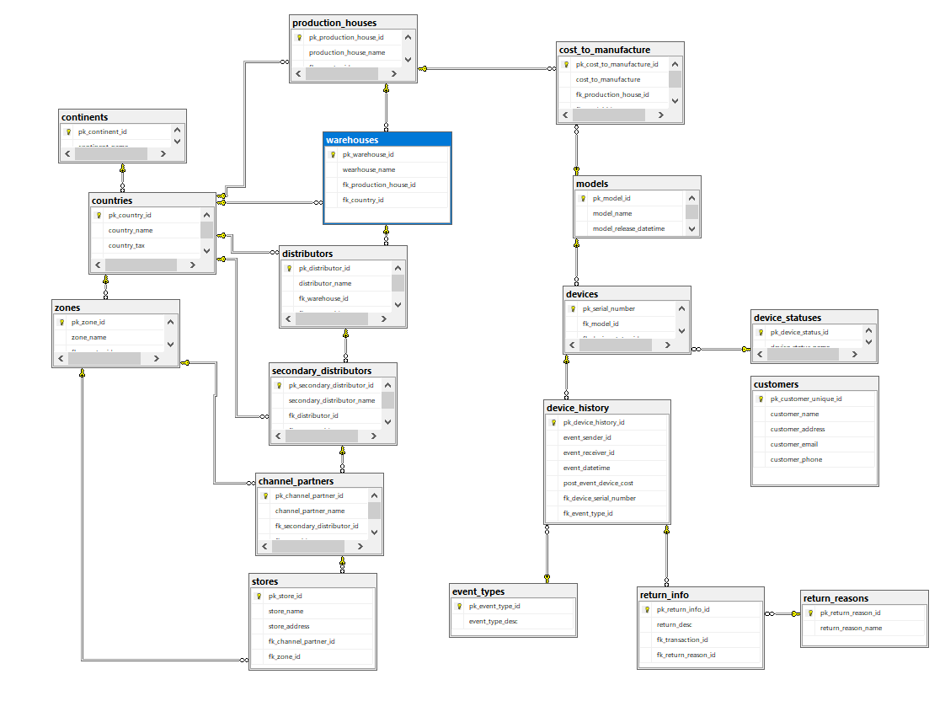
ER Diagram

Slide 4
Views and Functions
Event Views
Device Location Views
Helper Views
Availability Functions
Inventory Functions
History Functions

Slide 5
Stored Procedures
Event procedures
Populate data procedure

Slide 6

More features to add
More detailed return managing
Gather more data (location address, model specifications)
Even more functions and procedures

